Slide 1
Economics 187 Economic Forecasting
Lecture 17
State Space Models
Dr. Randall R. Rojas

Slide 2
State Space Models (SSM) (e.g., Kalman Filter)
Q: Why would you use Filtering techniques instead of e.g., ARIMA?
A: Smoothing techniques (such as filtering and spectral analysis) are often used to filter out random noise.
All previous time-series techniques discussed, relied consisted of regressions of present on past observations →Time Domain
Now we consider regressions of the present on periodic sines and cosines →Frequency Domain

Slide 3
State Space Models (e.g., Kalman Filter)
Main goals of filtering methods:
Identify the dominant frequencies in a series.
Find an explanation of the system from which the measurements were derived. This ‘explanation’ usually consists of only a few oscillations, therefore, its simpler and more physically meaningful.

Slide 4
Example: Deterministic Signal
x₁ = 2cos(2πt 6/100) + 3cos(2πt 6/100)
x₂ = 4cos(2πt 10/100) + 5cos(2πt 10/100)
x₃ = 6cos(2πt 40/100) + 7cos(2πt 40/100)
x = x₁ + x₂ +x₃
Summary: x is constructed from 3 signals with respective (f, A²) given by (0.06, 13), (0.10, 41), and (0.4, 85)
+

Slide 5
Example: Deterministic Signal
f=0.06, A² = 13 f=0.10, A² = 41
f=0.40, A² = 85 Sum

Slide 6
Example: Deterministic Signal
Q: If we only observe the final signal, can we infer its main ‘components’?
Yes! We look at the periodogram’s (FFT) frequencies and amplitudes.
A²=85
A²=41
A²=13
0.06
0.10
0.4

Slide 7
Example: Kalman Filter
Time Update
(Prediction)
Measurement Update
(Correction)
The time update projects the current state estimate ahead in time. The measurement update adjusts the projected estimate by an actual measurement at that time.

Slide 8
Example: Kalman Filter
The KF ‘data fusion algorithm’ consists of updating the means and (co)variances of process modeled.
Control Input Matrix
Effect of acceleration→position and velocity
State vector (position, velocity,…)
Transition Matrix
Position at t-1 →position at t
Velocity at t-1 →velocity at t
Vector of measurements
Transformation Matrix
Maps the state vector parameters into the measurement domain

Slide 9
Example: Kalman Filter
position
acceleration
Kinematic Equations of Motion
velocity

Slide 10
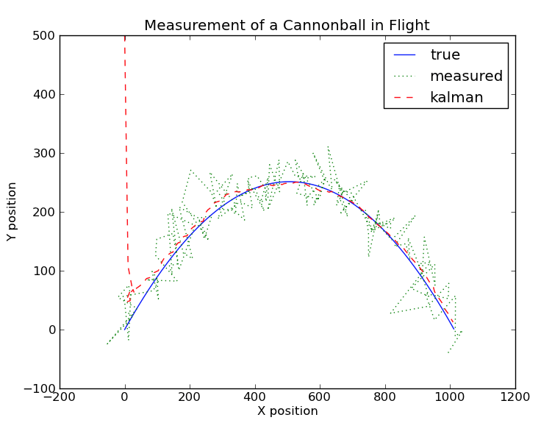
Example: Kalman Filter
Very noisy data!
KF performs well!

Slide 11
Filters vs. ARIMA

Slide 12
Filters vs. ARIMA
Fitted
Observations
Signal
Index

Slide 13
Results from the Kalman Filter
White noise statistical test suggest
the autocorrelation functions
are consistent white noise at 1%.
Our model seems to have
captured all the dynamics.

Slide 14
Results from ARMA
ARMA results are almost
identical to the KF results.
White noise statistical test suggest
the autocorrelation functions
are consistent white noise at 1%.
Our model seems to have
captured all the dynamics.

Slide 15
State Space Models vs. ARIMA, VAR, and others
Some Advantaged of SSM over ARIMA, VAR, …
Any ARIMA model can be represented in a state-space form, but only simple state-space models can be represented exactly in ARIMA form.
SSM easily handles structural breaks, shifts, and time-varying parameters of some static model.
SSM handles missing (and/or irregular) data better than e.g., ARIMA, VAR, …
SSM allows for changes on-a-fly parameters of the state-space model itself.
SSM models allows use of data from different sources simultaneously in the same model to estimate one underlying quantity.

